Slide 1
RECOGNITION
Thanks to Svetlana Lazebnik and Andrew Zisserman for the use of some slides

Slide 2
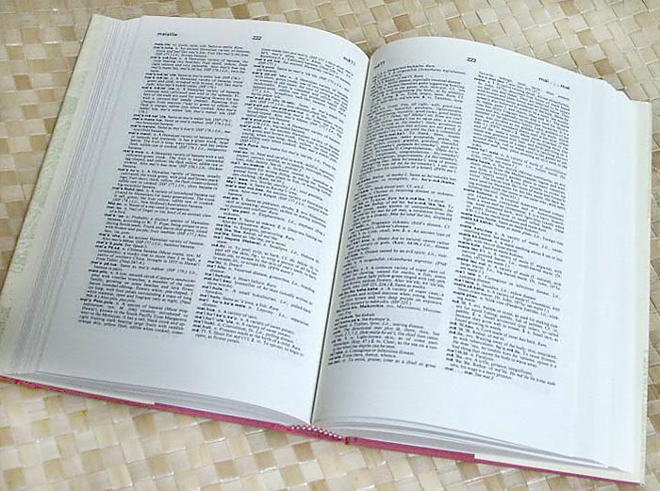
How many categories?

Slide 3
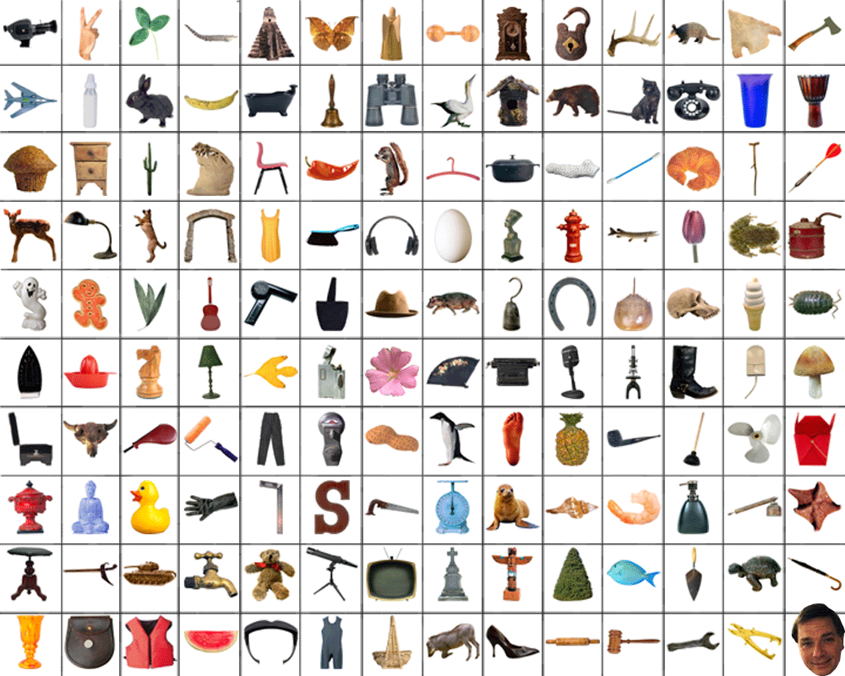
10,000-30,000

Slide 4
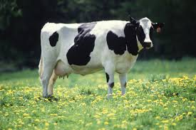
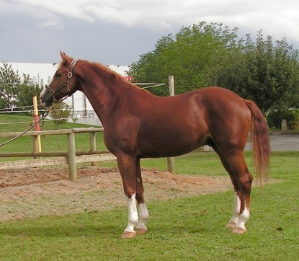
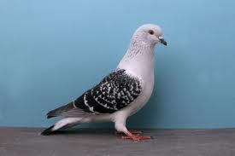
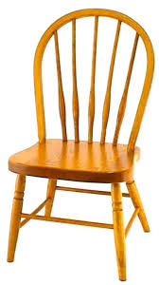
OBJECTS
ANIMALS
PLANTS
INANIMATE
NATURAL
MAN-MADE
…..
VERTEBRATE
MAMMALS
BIRDS
COW
HORSE
PIGEON
CHAIR

Slide 5
Variability makes recognition hard
Camera position
Illumination
Shape parameters
Within-class variations?

Slide 6
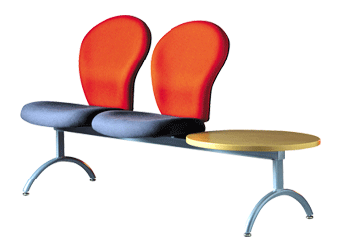


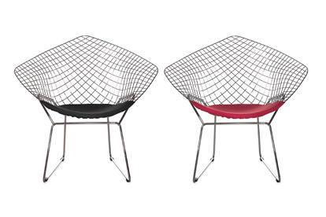
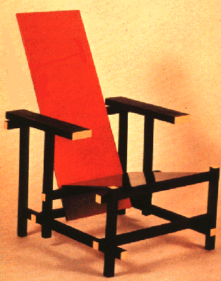
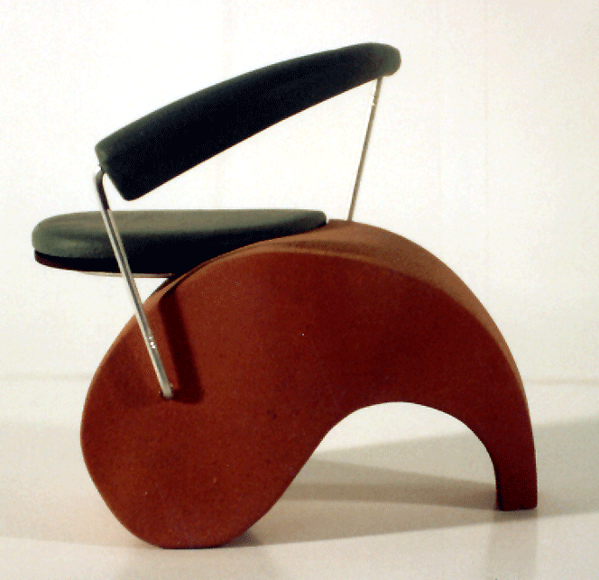
Variations within the same class

Slide 7
History
1960s – early 1990s: geometry
1990s: appearance
Mid-1990s: sliding window
Late 1990s: local features
Early 2000s: parts-and-shape models
Mid-2000s: bags of features
Present trends: data-driven methods, context

Slide 8
Alignment
Given a 3D model M and the image I of an object, we ask: could I be the image of M?

Slide 9
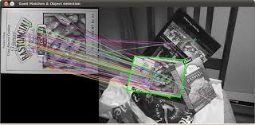
2D objects

Slide 10
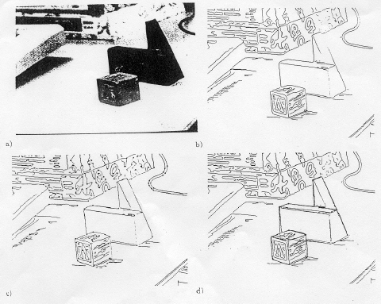
3D Objects

Slide 11
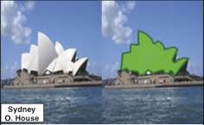
3D objects

Slide 12
Alignment becomes an instance of the general structure from motion problem
Can I match features in the two views such the transformation between the two views is rigid?
View 1 (model)
x_{i}
x_{i}
View 2 (image)
'
T

Slide 13
INVARIANTS

Slide 14
invariant to similarity transformations computed from four points
B
C
D
A
Projective invariants (Rothwell et al., 1992):

Slide 15
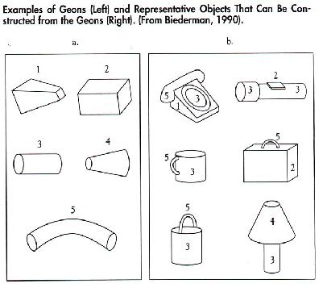
Recognition by components

Slide 16
Appearance

Slide 17
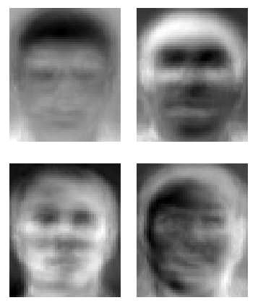
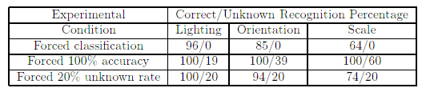
Eigenfaces (Turk & Pentland, 1991)

Slide 18
Color Histograms
Swain and Ballard, Color Indexing, IJCV 1991.

Slide 19
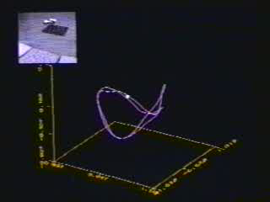
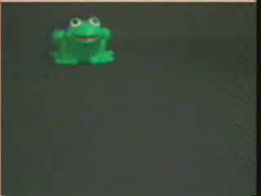
Appearance manifolds
H. Murase and S. Nayar, Visual learning and recognition of 3-d objects from appearance, IJCV 1995

Slide 20
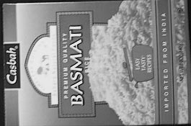
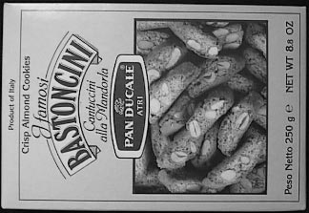

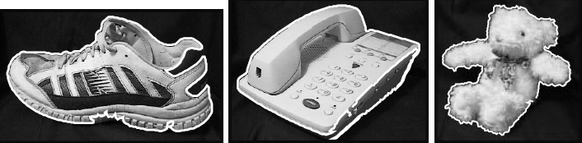
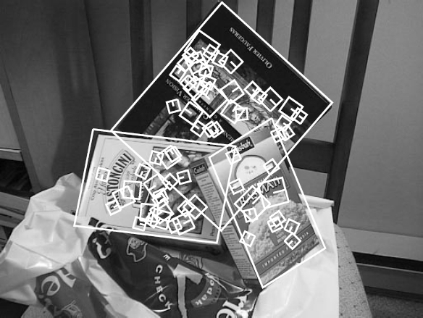
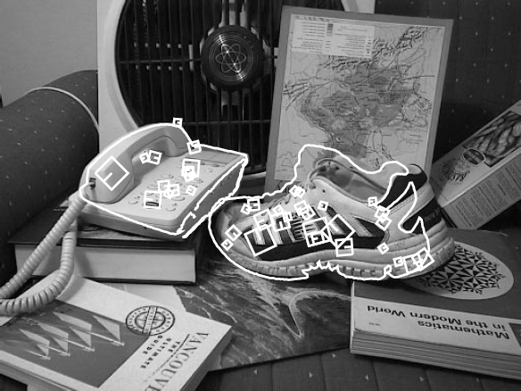
Local features
D. Lowe (1999, 2004)

Slide 21
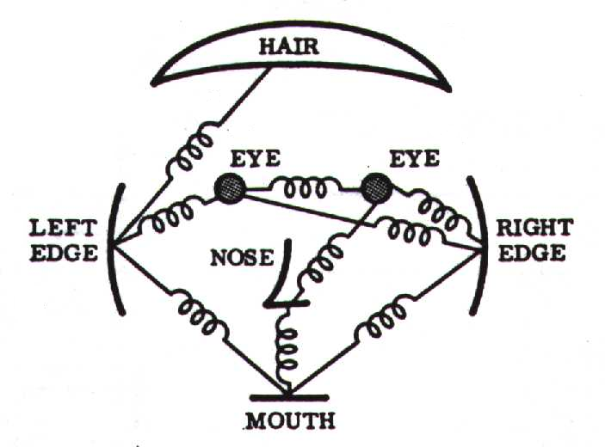
Parts-and-shape models
Model:
Object as a set of parts
Relative locations between parts
Appearance of part
Figure from [Fischler & Elschlager 73]

Slide 22
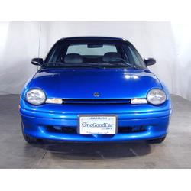
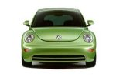
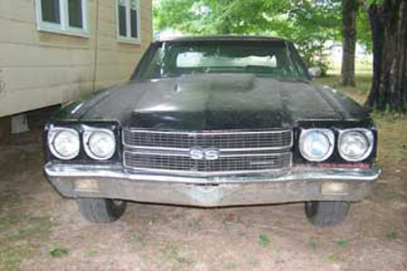
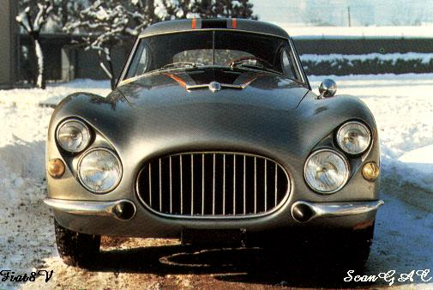
Constellation models
Weber, Welling & Perona (2000), Fergus, Perona & Zisserman (2003)
Notes:
Globally different, but have portions in common

Slide 23


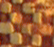





Objects as texture
All of these are treated as being the same – no segmentation (background, foreground)
Notes:
Motivation slide. Clearly location has to help, but bag-of-words doesn’t have it…

Slide 24
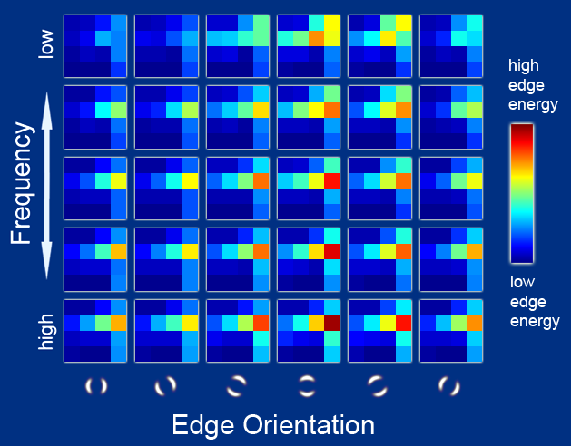
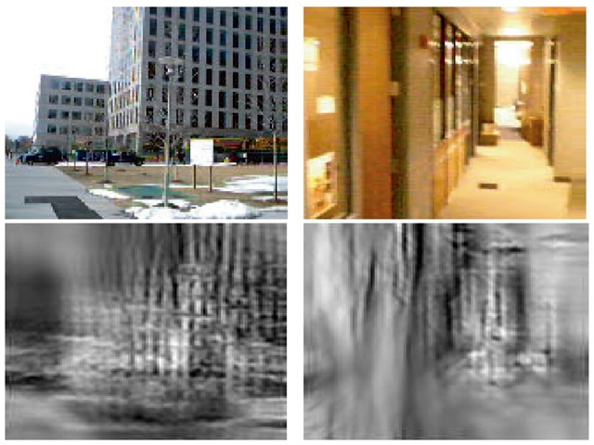
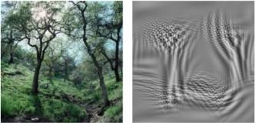
Global scene descriptors
The “gist” of a scene: Oliva & Torralba (2001)
http://people.csail.mit.edu/torralba/code/spatialenvelope/

Slide 25
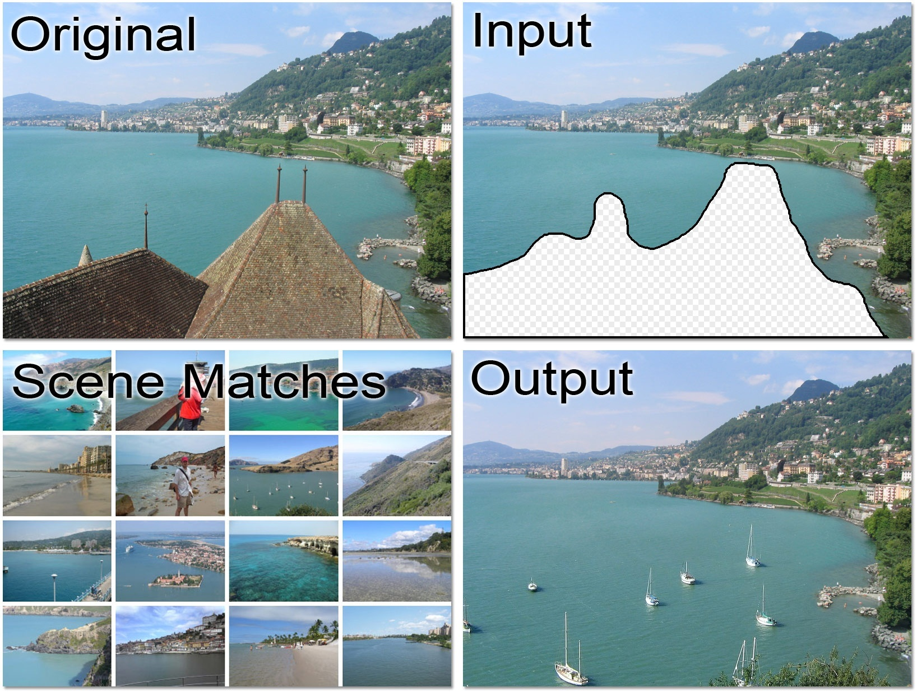
Data-driven methods
J. Hays and A. Efros, Scene Completion using Millions of Photographs, SIGGRAPH 2007

Slide 26
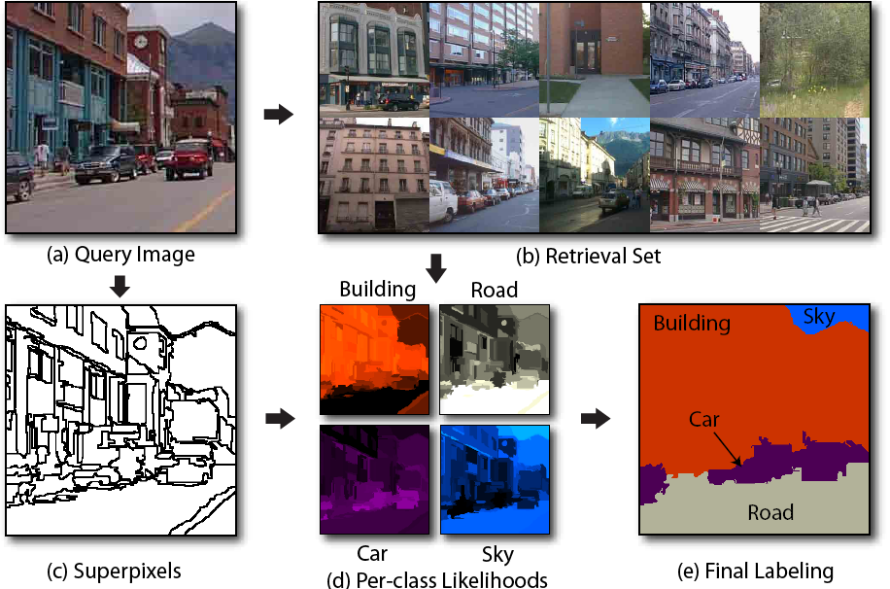
Data-driven methods
J. Tighe and S. Lazebnik, ECCV 2010

Slide 27
Overview
Basic recognition tasks
A statistical learning approach
Traditional or “shallow” recognition pipeline
Bags of features
Classifiers
Currently best approaches: neural networks and “deep” recognition pipeline

Slide 28
RECOGNITION AS AN APPLICATION OF MACHINE LEARNING

Slide 29
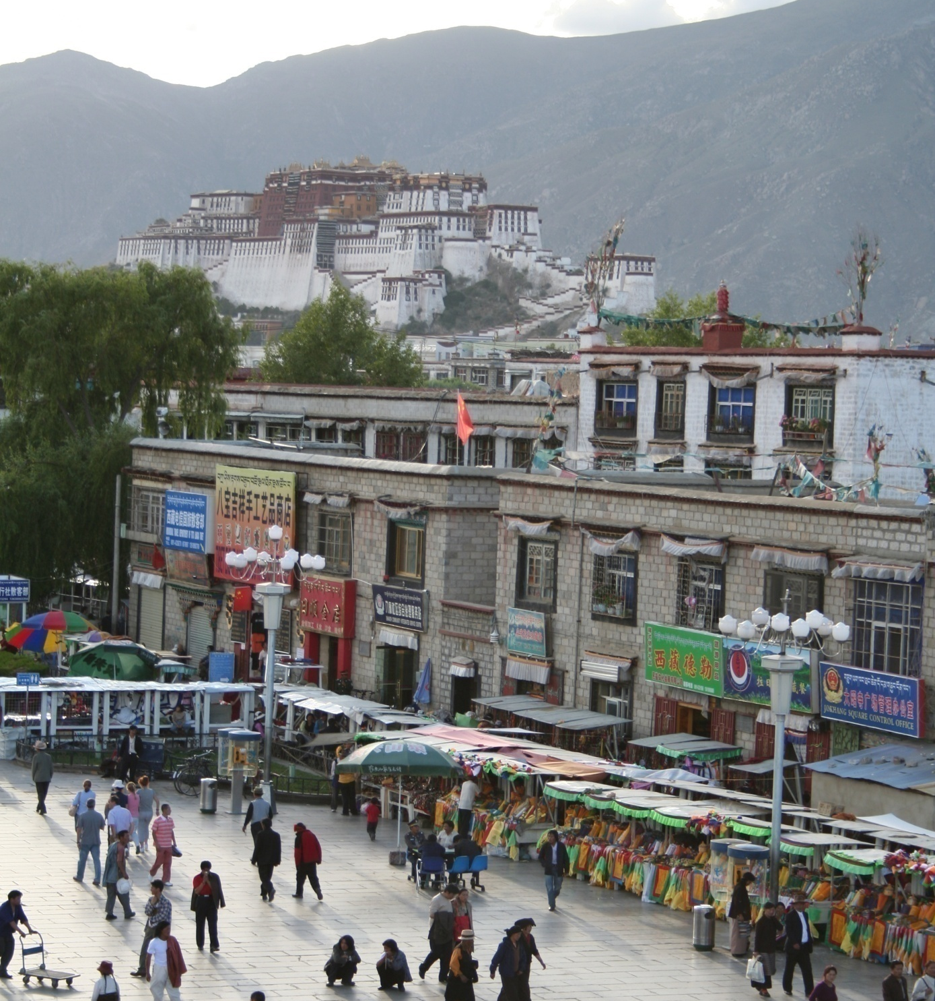
Common recognition tasks

Slide 30
Image classification
outdoor/indoor
city/forest/factory/etc.

Slide 31
Image tagging
street
people
building
mountain
…

Slide 32
Object detection
find pedestrians

Slide 33
Activity recognition
walking
shopping
rolling a cart
sitting
talking
…

Slide 34
Image parsing
sky
mountain
building
tree
building
banner
street lamp
market
people

Slide 35
Image description
This is a busy street in an Asian city. Mountains and a large palace or fortress loom in the background. In the foreground, we see colorful souvenir stalls and people walking around and shopping. One person in the lower left is pushing an empty cart, and a couple of people in the middle are sitting, possibly posing for a photograph.

Slide 36

Image classification

Slide 37
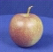
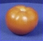
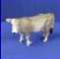
The statistical learning framework
Apply a prediction function to a feature representation of the image to get the desired output:
f( ) = “apple”
f( ) = “tomato”
f( ) = “cow”

Slide 38
The statistical learning framework
y = f(x)
Training: given a training set of labeled examples {(x₁,y₁), …, (x_{N},y_{N})}, estimate the prediction function f by minimizing the prediction error on the training set
Testing: apply f to a never before seen test example x and output the predicted value y = f(x)
output
prediction function
Image feature

Slide 39
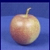
Steps
Training
Training Labels
Training Images
Image Features
Training
Learned model
Learned model
Testing
Image Features
Prediction
Test Image
Slide credit: D. Hoiem

Slide 40
Traditional recognition pipeline
Hand-designed feature extraction
Trainable classifier
Image
Pixels
Object Class
Features are not learned
Trainable classifier is often generic (e.g. SVM)

Slide 41
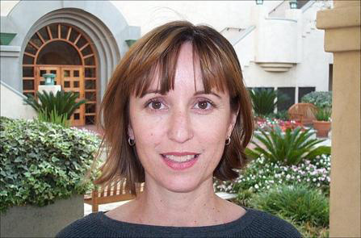
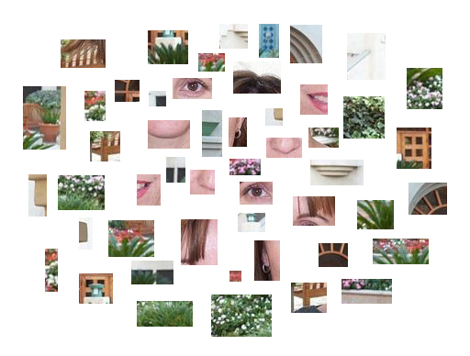
Bags of features

Slide 42
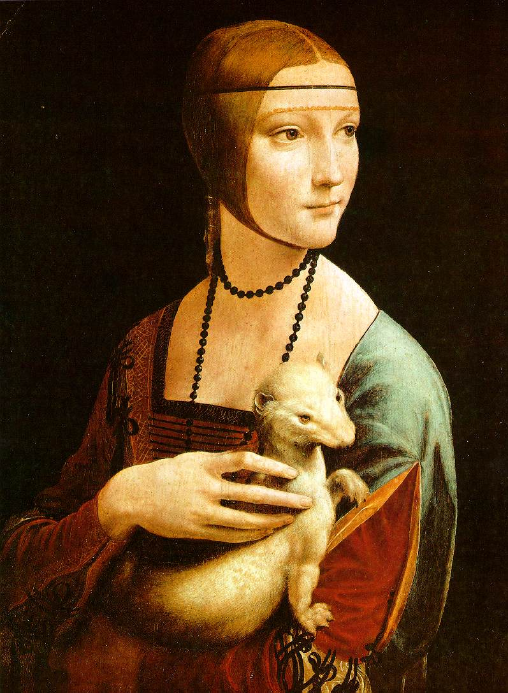
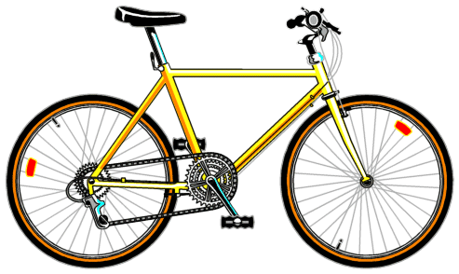
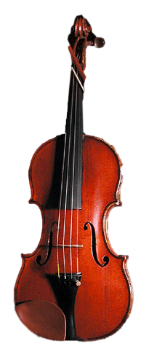
Traditional features: Bags-of-features
Extract local features
Learn “visual vocabulary”
Quantize local features using visual vocabulary
Represent images by frequencies of “visual words”

Slide 43
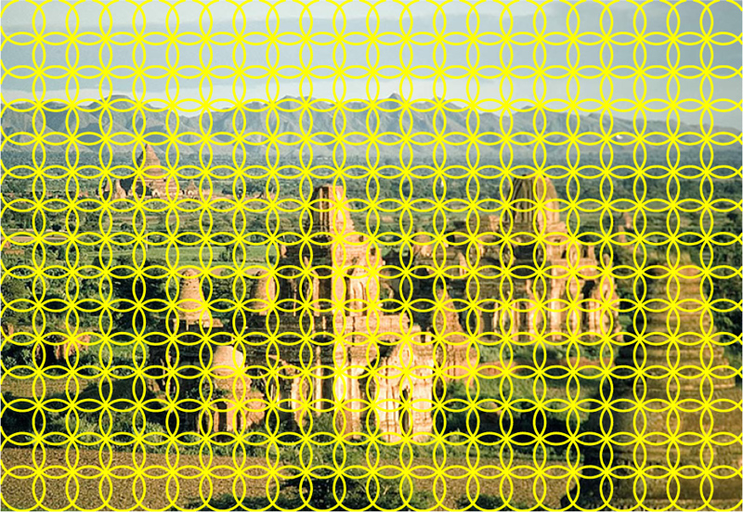
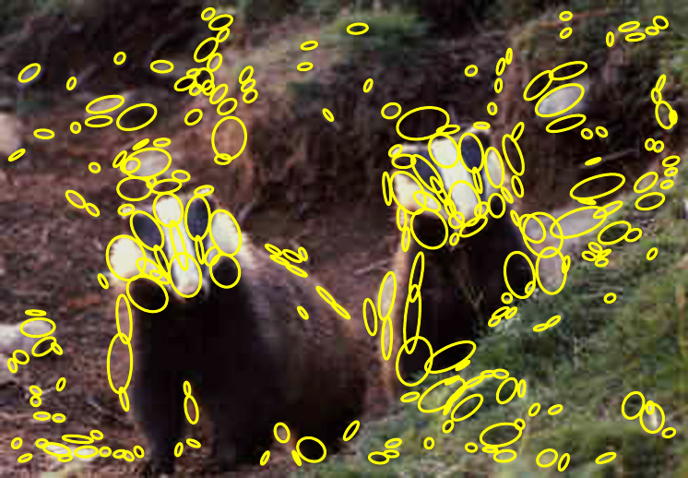
1. Local feature extraction
Sample patches and extract descriptors

Slide 44
2. Learning the visual vocabulary
…
Extracted descriptors from the training set
Slide credit: Josef Sivic

Slide 45
2. Learning the visual vocabulary
…
Clustering
Slide credit: Josef Sivic

Slide 46
2. Learning the visual vocabulary
Visual vocabulary
…
Clustering
Slide credit: Josef Sivic

Slide 47
Review: K-means clustering
Want to minimize sum of squared Euclidean distances between features x_{i} and their nearest cluster centers m_{k}
Algorithm:
Randomly initialize K cluster centers
Iterate until convergence:
Assign each feature to the nearest center
Recompute each cluster center as the mean of all features assigned to it

Slide 48
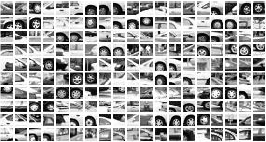
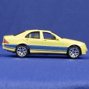
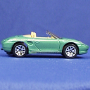
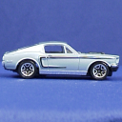













Example visual vocabulary
…
Appearance codebook
Source: B. Leibe

Slide 49
Bag-of-features steps
Extract local features
Learn “visual vocabulary”
Quantize local features using visual vocabulary
Represent images by frequencies of “visual words”

Slide 50
Bags of features: Motivation
Orderless document representation: frequencies of words from a dictionary Salton & McGill (1983)

Slide 51

Bags of features: Motivation
Orderless document representation: frequencies of words from a dictionary Salton & McGill (1983)
US Presidential Speeches Tag Cloud http://chir.ag/projects/preztags/

Slide 52

Bags of features: Motivation
Orderless document representation: frequencies of words from a dictionary Salton & McGill (1983)
US Presidential Speeches Tag Cloud http://chir.ag/projects/preztags/

Slide 53

Bags of features: Motivation
Orderless document representation: frequencies of words from a dictionary Salton & McGill (1983)
US Presidential Speeches Tag Cloud http://chir.ag/projects/preztags/

Slide 54


Spatial pyramids
level 0
Lazebnik, Schmid & Ponce (CVPR 2006)

Slide 55




Spatial pyramids
level 0
level 1
Lazebnik, Schmid & Ponce (CVPR 2006)

Slide 56
















Spatial pyramids
level 0
level 1
level 2
Lazebnik, Schmid & Ponce (CVPR 2006)

Slide 57


Spatial pyramids
Scene classification results

Slide 58















Spatial pyramids
Caltech101 classification results

Slide 59
Traditional recognition pipeline
Hand-designed feature extraction
Trainable classifier
Image
Pixels
Object Class

Slide 60
Classifiers: Nearest neighbor
Test example
Training examples from class 2
Training examples from class 1
f(x) = label of the training example nearest to x
All we need is a distance function for our inputs
No training required!
Notes:
“Non-parametric” classifier: the entire training set is essentially the model parameters.
Pros:
Very fast at training time
Flexible: all it requires is a way to compute similarity or distances between pairs of features. Applies to many different kinds of features.
Works with any number of classes.
Works well in practice for large datasets (but see cons)
Cons:
Slow at test time (need to compute distances between test example and every training example)

Slide 61

K-nearest neighbor classifier
For a new point, find the k closest points from training data
Vote for class label with labels of the k points
k = 5

Slide 62

K-nearest neighbor classifier
Which classifier is more robust to outliers?
Credit: Andrej Karpathy, http://cs231n.github.io/classification/

Slide 63

K-nearest neighbor classifier
Credit: Andrej Karpathy, http://cs231n.github.io/classification/

Slide 64
Linear classifiers
Find a linear function to separate the classes:
f(x) = sgn(w ⋅ x + b)
Notes:
“Parametric” classifier: model defined by a small number of parameters (w, b)
Pros:
Very fast at test time
Cons:
Slow at training time: need to estimate the parameters
Only works for two classes
Data may not be linearly separable

Slide 65


Visualizing linear classifiers
Source: Andrej Karpathy, http://cs231n.github.io/linear-classify/

Slide 66
Nearest neighbor vs. linear classifiers
NN pros:
Simple to implement
Decision boundaries not necessarily linear
Works for any number of classes
Nonparametric method
NN cons:
Need good distance function
Slow at test time
Linear pros:
Low-dimensional parametric representation
Very fast at test time
Linear cons:
Works for two classes
How to train the linear function?
What if data is not linearly separable?

Slide 67
Support vector machines
When the data is linearly separable, there may be more than one separator (hyperplane)
Which separator is best?

Slide 68
Support vector machines
Find hyperplane that maximizes the margin between the positive and negative examples
For support vectors,
Distance between point and hyperplane:
Therefore, the margin is 2 / ||w||
Support vectors
Margin
C. Burges, A Tutorial on Support Vector Machines for Pattern Recognition, Data Mining and Knowledge Discovery, 1998

Slide 69
Finding the maximum margin hyperplane
Maximize margin 2 / ||w||
Correctly classify all training data:
Quadratic optimization problem:
C. Burges, A Tutorial on Support Vector Machines for Pattern Recognition, Data Mining and Knowledge Discovery, 1998

Slide 70
SVM parameter learning
Separable data:
Non-separable data:
Maximize margin
Classify training data correctly
Maximize margin
Minimize classification mistakes

Slide 71

SVM parameter learning
+1
Margin
0
-1
Demo: http://cs.stanford.edu/people/karpathy/svmjs/demo

Slide 72

Nonlinear SVMs
General idea: the original input space can always be mapped to some higher-dimensional feature space where the training set is separable
Φ: x → φ(x)
Image source

Slide 73
Nonlinear SVMs
Linearly separable dataset in 1D:
Non-separable dataset in 1D:
We can map the data to a higher-dimensional space:
0
x
0
x
x²
0
x
Slide credit: Andrew Moore

Slide 74
The kernel trick
General idea: the original input space can always be mapped to some higher-dimensional feature space where the training set is separable
The kernel trick: instead of explicitly computing the lifting transformation φ(x), define a kernel function K such that K(x , y) = φ(x) · φ(y)
(to be valid, the kernel function must satisfy Mercer’s condition)

Slide 75
The kernel trick
Linear SVM decision function:
learned weight
Support vector
C. Burges, A Tutorial on Support Vector Machines for Pattern Recognition, Data Mining and Knowledge Discovery, 1998

Slide 76
The kernel trick
Linear SVM decision function:
Kernel SVM decision function:
This gives a nonlinear decision boundary in the original feature space
C. Burges, A Tutorial on Support Vector Machines for Pattern Recognition, Data Mining and Knowledge Discovery, 1998

Slide 77


Polynomial kernel:

Slide 78

Gaussian kernel
Also known as the radial basis function (RBF) kernel:
K(x, y)
||x – y||

Slide 79

Gaussian kernel
SV’s

Slide 80
Kernels for histograms
Histogram intersection:
Square root (Bhattacharyya kernel):

Slide 81
SVMs: Pros and cons
Pros
Kernel-based framework is very powerful, flexible
Training is convex optimization, globally optimal solution can be found
Amenable to theoretical analysis
SVMs work very well in practice, even with very small training sample sizes
Cons
No “direct” multi-class SVM, must combine two-class SVMs (e.g., with one-vs-others)
Computation, memory (esp. for nonlinear SVMs)

Slide 82

Generalization
Generalization refers to the ability to correctly classify never before seen examples
Can be controlled by turning “knobs” that affect the complexity of the model
Training set (labels known)
Test set (labels unknown)

Slide 83
Diagnosing generalization ability
Training error: how does the model perform on the data on which it was trained?
Test error: how does it perform on never before seen data?
Underfitting
Overfitting
Error
Test error
Training error
Low
Model complexity
High
Source: D. Hoiem

Slide 84

Underfitting and overfitting
Underfitting: training and test error are both high
Model does an equally poor job on the training and the test set
Either the training procedure is ineffective or the model is too “simple” to represent the data
Overfitting: Training error is low but test error is high
Model fits irrelevant characteristics (noise) in the training data
Model is too complex or amount of training data is insufficient
Underfitting
Good generalization
Overfitting
Figure source

Slide 85
Effect of training set size
Few training examples
Test Error
Many training examples
Low
Model complexity
High
Source: D. Hoiem
Notes:
Note: these figures don’t work in pdf

Slide 86
Validation
Split the data into training, validation, and test subsets
Use training set to optimize model parameters
Use validation test to choose the best model
Use test set only to evaluate performance
Stopping point
Test set loss
Error
Validation
set loss
Training set loss
Model complexity

Slide 87

Summary
The different steps

